Slide 1






Learning Temporal Mobility Patterns to Improve QoS in Mobile Wireless Communications
Satyaki Roy₁, Bilas Chandra₂, Anubhav Anand₂,
Preetam Ghosh₃ and Nirnay Ghosh₂
University of North Carolina, Chapel Hill, USA₁
IIEST, Shibpur, India₂
Virginia Commonwealth University, Virginia, USA₃
Date: January 11th, 2021

Slide 2

Quick glance
Background
Contributions
System model
Approach
Results
Conclusions

Slide 3
Background

Slide 4
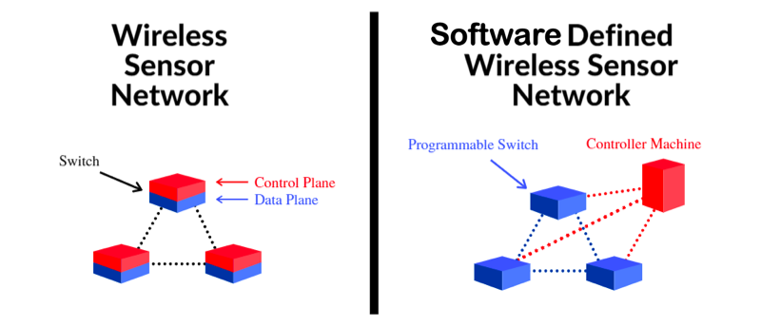
Wireless Sensor Networks (WSN).
dedicated networks of sensors that monitor physical phenomena like temperature, humidity, noise, pollution, etc.
data collected by each device is often offloaded to the base station (BS) by multi-hop communication₁
Challenges associated with wireless communications:
Limited battery power
Processing capacity
Memory resources₂
Developments in WSN applications, such as habitat monitoring, battlefield surveillance, and object tracking, require mobile sensing devices.
Figure. Wireless sensor networks and software defined wireless sensor networks
[1] S. Tree. Wireless sensor networks. Self, 1(R2):C0, 2014.
[2] N. Correal and N. Patwari. Wireless sensor networks: Challenges and opportunities. In MPRG/Virgina Tech Wireless Symposium. Citeseer, 2001.

Slide 5
Routing tasks in mobile WSNs are worsened by unpredictable topology changes and path failures₃.
Particularly, in post-disaster scenarios, the mobile devices comprise the smart devices in the possession of the survivors, which they use to form ad hoc Bluetooth or Wi-Fi based WSNs.
Under such scenarios, poor data routing will disrupt communication with the BS and prevent the survivors from availing life-saving resources or search and rescue operations.
Thus, devising efficient routing techniques that minimize delay, overhead, and energy overheads continues to be an active area of research₄.
[3] S. Ali, S. Madani, I. Khan, et al. Routing protocols for mobile sensor networks: A comparative study. arXiv preprint arXiv:1403.3162, 2014. [4] Y. Jahir et al. Routing protocols and architecture for disaster area network: A survey. Ad Hoc Networks, 82:1–14, 2019.

Slide 6
Related works
The routing protocols for mobile ad hoc networks attempt to tackle the uncertainty imposed by the mobility of the sensor nodes by identifying reliable neighbors and routes to the base station.
Toh et al. presented an ad-hoc routing protocol where associativity-based routing is employed to find stable routes, resulting in higher throughput [5].
Marwaha et al. introduced a routing scheme that augments the on-demand routing capability of Ad Hoc On-Demand Distance Vector with distributed topology discovery, reducing communication delay [6].
Ramasubramanian presented a hybrid routing protocol, called Sharp Hybrid Adaptive Routing Protocol (SHARP), that merges the features of proactive and reactive routing by calibrating the extent of route information dissemination versus the discoverability [7]. SHARP is able to dynamically adapt to the variations in network topology, traffic pattern, etc.
Kim et al. proposed a self-organization routing protocol for mobile sensor networks, where the mobile devices are assigned to cluster heads representing self-organized clusters [8].
[5] C. Toh. A novel distributed routing protocol to support ad-hoc mobile computing. In Conference Proceedings of the 1996 IEEE Fifteenth Annual International Phoenix Conference on Computers and Communications, pages 480–486, 1996.
[6]. S. Marwaha, C. Tham, and D. Srinivasan. Mobile agents based routing protocol for mobile ad hoc networks. In Global Telecommunications Conference, 2002. GLOBECOM’02. IEEE, volume 1, pages 163–167. IEEE, 2002.
[7] V. Ramasubramanian, Z. Haas, and E. Sirer. Sharp: A hybrid adaptive routing protocol for mobile ad hoc networks. In Proceedings of the 4th ACM international symposium on Mobile ad hoc networking & computing, pages 303–314, 2003.
[8] D. Kim and Y. Chung. Self-organization routing protocol supporting mobile nodes for wireless sensor network. In First International Multi-Symposiums on Computer and Computational Sciences (IMSCCS’06), volume 2, pages 622–626. IEEE, 2006.

Slide 7
Related works
Huang et al. proposed a distributed routing protocol where nodes cooperatively achieve robustness against path breakdown due to mobility, failure, channel impairments, etc. [9].
Communication in a disaster response scenario is further challenged by erratic human mobility. To address them, Uddin et al. employ the notion of inter contact routing that pinpoints reliable routes from route delays and delivery probabilities, thereby controlling data replication [10].
Macone et al. introduced a reinforcement learning-based routing protocol, which maximizes the minimum node lifetime and adapt to changing topologies [11].
Wang et al. presented a signal-based routing to improve network reliability, which favors known routes early on but gradually utilizes the paths with strongest signals for data forwarding [12].
Shah et. al. conceived a cluster-based routing strategy that maximizes network lifetime by channeling the traffic via the mobile devices possessed by the groups of survivors gathered in shelter points [13].
Abhishek et al. present an adaptive and energy-efficient routing approach that determines routes based on factors such as, environment, residual energy, signal strength, etc. [14].
[9] X. Huang et al. Robust cooperative routing protocol in mobile wireless sensor networks. IEEE transactions on wireless communications, 7(12):5278–5285, 2008.
[10] M. Uddin, H. Ahmadi, T. Abdelzaher, and R. Kravets. A low-energy, multi-copy inter-contact routing protocol for disaster response networks. In 2009 6th Annual IEEE Communications Society Conference on Sensor, Mesh and Ad Hoc Communications and Networks, pages 1–9. IEEE, 2009.
[11] D. Macone et al. Mq-routing: Mobility-, gps -and energy-aware routing protocol in manets for disaster relief scenarios. Ad Hoc Networks, 11(3):861–878, 2013.
[12] S. Wang et al. Signal strength-based routing protocol for mobile ad hoc networks. In 19th International Conference on Advanced Information Networking and Applications (AINA’05) Volume 1 (AINA papers), volume 2, pages 17–20. IEEE, 2005.
[13] V. Shah, S. Roy, S. Silvestri, and S. Das. Ctr: Cluster based topological routing for disaster response networks. In 2017 IEEE International Conference on Communications (ICC), pages 1–6. IEEE, 2017.
[14] T. Abishek et al. Aer: Adaptive energy efficient routing protocol for network of flying robots monitoring over disaster hit area. In 2012 21st Annual Wireless and Optical Communications Conference (WOCC), pages 166–169. IEEE, 2012.

Slide 8
Contribution

Slide 9
In this paper we study how the knowledge of the mobility pattern of the nodes can help to improve the QOS of WSN.
We generate mobility traces using 2D waypoints in Rome , Italy and use the Routing protocol for Low power and Lassy Network (RPL) as a baseline.
Supervised Machine Learning approaches like SVM can accurately predict the mobility pattern of human mobility.
With help of periodicity we can present a spatiotemporal view of dynamically evolving mobile WSN which can tackle the uncertainties imposed due to changing network topology.
The periodicity based routing exhibits an improvement over RPL in QoS , measured in terms of PDR and communication latency.

Slide 10
System
Model

Slide 11
Scenario.
Our system model is set in a post disaster scenario where a set of mobile nodes are carrying wireless devices capable of sensing and communication.
The mobile nodes visit the waypoints which may be safe shelters.
The mobile nodes form a dynamic mobile WSN.
Events.
Each event location consist of identification , location and timestamp.
The mobile devices sense the event in their communication range and then reports it to the base station.
Base station.
It is centrally located and accessible by the sensors.
It carries out aggregation and processing on the received event data.
It has a higher communication range and is not constrained with respect to processing, storage, and energy.
The BS also operates the SDN controller determines the network parameters based on
(1) knowledge of the network topology
(2) residual energy of devices at any given time₁₆
[16] S. Roy et al. Adaptive motif-based topology control in mobile software defined wireless sensor networks. In 2021 IEEE 18th Annual Consumer Communications & Networking Conference (CCNC), pages 1–6. IEEE, 2021

Slide 12
Mobile sensors.
They are capable of sensing events and communicating with other nodes using short-range radio communication (such as Mesh logic and ZigBee)₁₇
They are rechargeable, energy- and storage-constrained and act as source as well as intermediaries.
We assume that each node tends to periodically visit p waypoints (where p is its periodicity).
[17] B. Sundararaman, et al. "Clock synchronization for wireless sensor networks: a survey." Ad hoc networks 3, no. 3 (2005): 281-323.

Slide 13
Approach

Slide 14
Generation of Trip
Each individual u with periodicity p periodically visits a set of waypoints denoted as z ∈ π(u) (where period vector π|(u)| = p) in the order of appearance in the list.
A node with p = 4 & π = [0, 1, 3, 2] visits 0, 1, 3, 2, 0, 1, . . . until the trip plan is reset and p and π are re-initialized.
For each node we generate π from the inter-zone mobility patterns given by a transition matrix A.
A[i,j] denotes the probability of traveling from zone z_{i} to z_{j}.
π is calculated using the first-order Markov Chain model.
The next waypoint only depends on the current waypoint in π.

Slide 15
Temporal Feature Engineering
We apply ML models to learn the periodicity vector (π) of the nodes.
By knowing π, we can predict the future location of the nodes with greater certainty.
We have used a sliding window approach to learn X and y vectors on the most recent temporal mobility patterns of the nodes in the last W time-points.
Updating Mobility Parameter
Each node may intermittently update his itinerary that may add more uncertainty rendering the previously learnt parameters ineffective.
If the accuracy drops down below the threshold parameter(defined by us) then ML parameters will need to be relearned.

Slide 16
Spatio-temporal View of Mobile WSN
The major characteristic of improving QoS during mobile wireless communications is to identify stable or reliable routes between any node and Base Station.
Static networks tend to exhibit improved QoS.
We attempt to leverage the notion of node periodicity to create a static representation of the dynamic network topology.

Slide 17
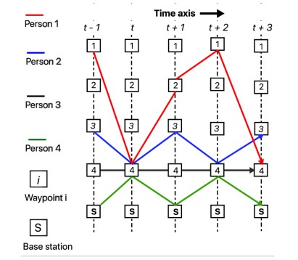
Spatio-temporal View of Mobile WSN
The graphical representation of the spatiotemporal contact consists of T instances of each waypoint as node.
Link exists between instances of waypoint(i, j) which shows individual travel from waypoint i to j during the time interval t to t + 1.
In the given figure we can see the base Station BS and individuals u = 1, 2, 3, 4 in red, blue, black and green colors, with periodicity vectors [4, 2, 1, 4], [3, 4], [4], and [S, 4] starting at time t.
With the knowledge of the periodicity of 3 & 4, person 2 may choose to forward data to node 4, since person 4 frequently visits the BS.
Thus, the knowledge of periodicity helps tackle the uncertainty imposed due to human mobility.
Graphical representation of the spatiotemporal contact

Slide 18
Training and Testing
Our ML parameters for training and testing the model are based on the mobility of each node.
Input parameters:
Accuracy threshold τ
Number of waypoints Z
Trip reset probability r
Trip period p
Feature count f
Duration T
Periodic trip tp
Training and testing window W_{train} and W_{test}
The algorithm initializes accuracy A, ML parameter C, and iterator i.
It iterates T times and in each iteration t we have the following steps:
In each iteration our node generates trip vector tp with reset probability r and adds the first waypoint to the trip information vector D or the i^{th} waypoint of tp is added to D.
If t = 0 or the accuracy A drops below the threshold τ, D is used to learn the feature and label vectors X and y.
The ML parameters C are learned using the fit(X,y) function.
The algorithm then monitors the accuracy A in predicting the last W_{test} waypoint visits.

Slide 19
Results

Slide 20
Scenario.
We create a customized simulation environment based on the SimPy library₁₈ to capture the interaction among the nodes and the base station.
The simulations are carried out on 100 nodes over a period of 150 minutes.
Nodes move to a new waypoint once in every 2 minutes and sense event data once every minute.
Generation of event/task data.
50 events take place uniformly across the area per minute.
We use the Deconet Public Transport Network Data Repository₁₉, which houses public transport schedules in the form of networks with waypoints as nodes and inter-waypoint traffic as link weight.
We pick out 19 waypoints out of 8000 waypoints from Rome, Italy for the simulation and generate the inter-waypoint transition matrix .
An additional waypoint (labeled 0) serves as the base station and is placed at the centroid.

Slide 21
ML Model
We employ SVM to learn the human mobility patterns, by predicting the next waypoint visits based on recent trips.
RPL
It is a distance vector proactive routing protocol employed to direct traffic towards the base station.
We use RPL as a baseline routing approach.
Metrics
Two metrics have been considered:
Packet Delivery Ratio is defined as the ratio between the number of unique packets received by the BS to number of unique packets sensed by all the nodes.
Latency is measured in terms of the time(in minutes) elapsed between the occurrence of events and its recipient by BS.

Slide 22
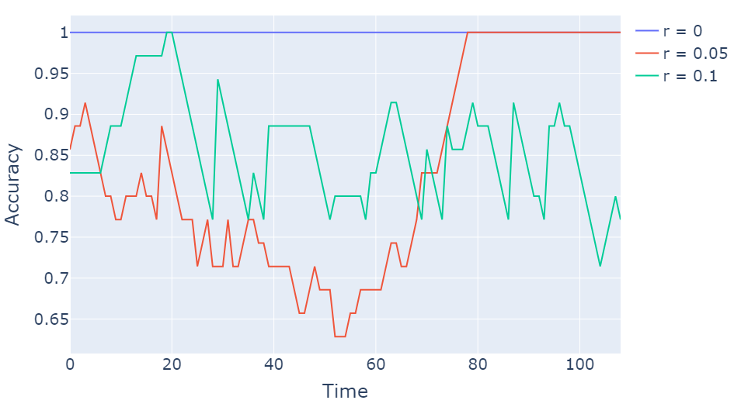
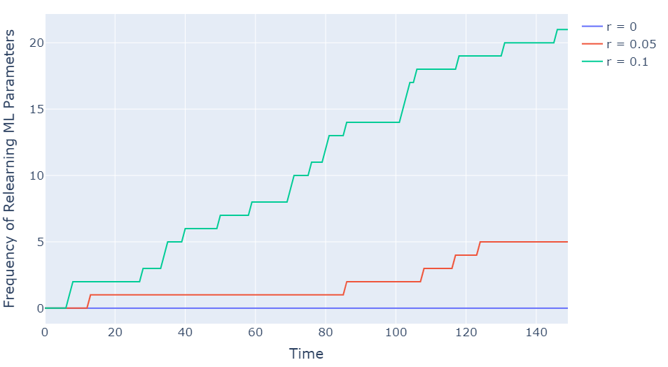
Effect of Reset Probability
Effect of trip reset probability on Accuracy
A person resets his trip with a probability r, causing him/her to regenerate the periodicity vector.
For r = 0, there us no uncertainty in the person’s trip.
For higher r values like r = 0.05, 0.1, the SVM classifier yields lower accuracy in the prediction of the next waypoint.
Effect of trip reset probability on Parameter Relearning Frequency

Slide 23
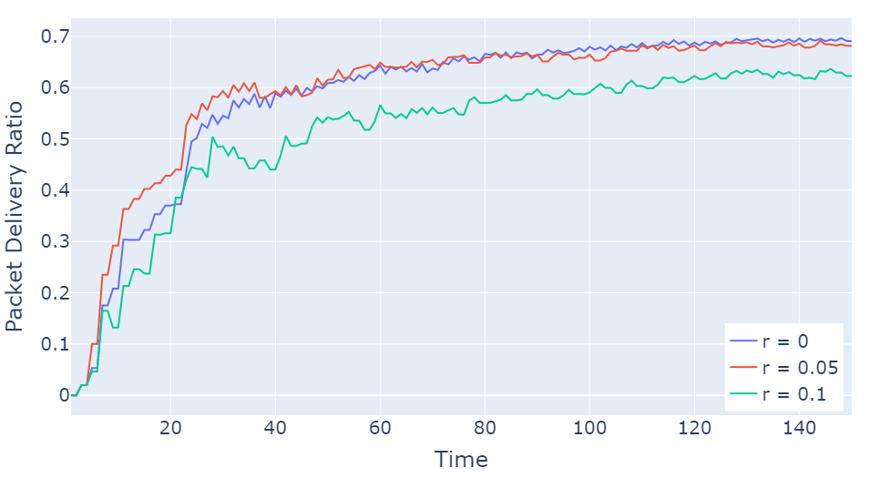
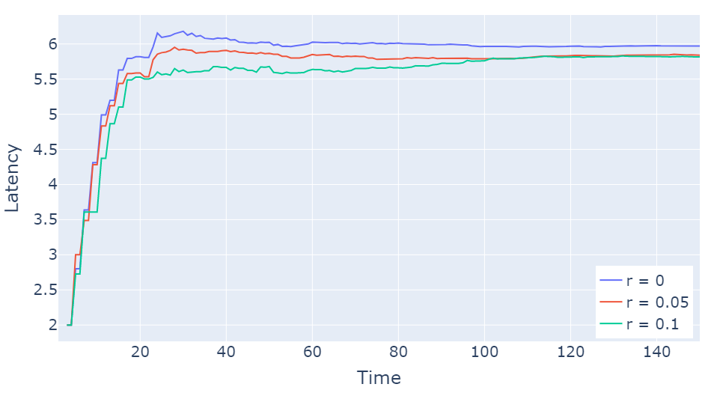
Effect of Reset Probability on QoS
Effect of trip reset probability on PDR
In the periodicity-based routing PDR decreases significantly as r increases.
The latency for r = 0, 0.05 is higher than that of r = 0.1, because in the latter’s case, a lot of event data sent along longer routes remain undelivered.
Effect of trip reset probability on Latency

Slide 24
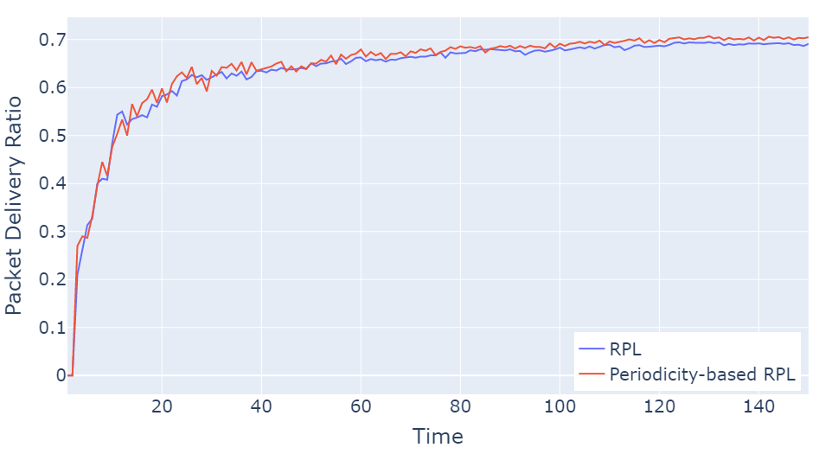
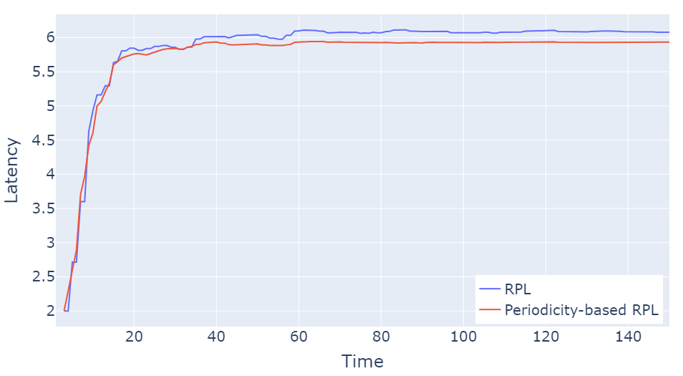
Comparison with Baseline
Comparison of Packet Delivery Ratio
Comparison of Latency
The proposed periodicity-based routing exhibits an improvement in cumulative PDR and lower cumulative latency than the traditional RPL.

Slide 25
Conclusions

Slide 26
We proposed to improve the QoS of routing in MWSN by learning the periodicity in the waypoint visits of mobile nodes.
We presented a spatio-temporal representation of MWSN that helped overcome the adverse effects of the dynamic network topology on the overall QoS.
We designed a discrete event platform designed using Python SimPy library to carry out extensive simulation experiments and verify the efficacy of the proposed periodicity-based data routing.
We showed that the proposed approach, employing SVM to learn mobility periodicity, outperforms RPL in terms of PDR and communication latency.
Future works.
We will compare the performance of periodicity-based routing for a variety of machine learning approaches and routing protocols.
We will devise a distributed version of the proposed approach, where mobile nodes learn the periodicity of peer nodes through message passing and autonomously take routing decisions without the dependency of a centralized controller.

Slide 27

Questions ?
Email: satyakir@unc.edu, sr3k2@mst.edu

